Slide 1




HOTEL AGGREGATOR ANALYSIS
By Bhavana Raj S N

Slide 2
PROJECT AIM
ANALYSE AND VISUALISE
HOTEL AGGREGATOR DATA USING TABLEAU

Slide 3
PROJECT INTRODUCTION
The goal of this internship project is to analyze a dataset of hotel aggregator listings using Tableau. The dataset includes various attributes related to listings, hosts, reviews, and availability. The objective is to create comprehensive visualizations and insights to uncover trends, patterns, and factors influencing listing performance. Interns will utilize Tableau to explore key metrics such as pricing, availability, host characteristics, and review scores, aiming to derive actionable insights for enhancing the overall quality and competitiveness of the listings.

Slide 4
- Visualize the distribution of listings on a map to identify popular neighborhoods.
- Explore the geographical concentration of listings and host locations.
01 - GEOGRAPHICAL INSIGHTS:
- Analyze pricing trends based on property types, room types, and accommodation capacity.
- Investigate the availability of listings over time and identify peak periods.
02 - PRICING AND AVAILABILITY ANALYSIS:
- Evaluate host characteristics, including superhost status, response times, and verification methods.
- Explore correlations between host attributes and listing performance.
03 - HOST PERFORMANCE:
- Examine review scores and their impact on overall listing performance.
- Identify areas for improvement based on specific review categories.
04 - REVIEW SCORES AND GUEST SATISFACTION:
- Analyse the distribution of property types and room types.
- Explore trends in the popularity of specific accommodation setups.
05 - PROPERTY TYPE AND ROOM ANALYSIS:

Slide 5
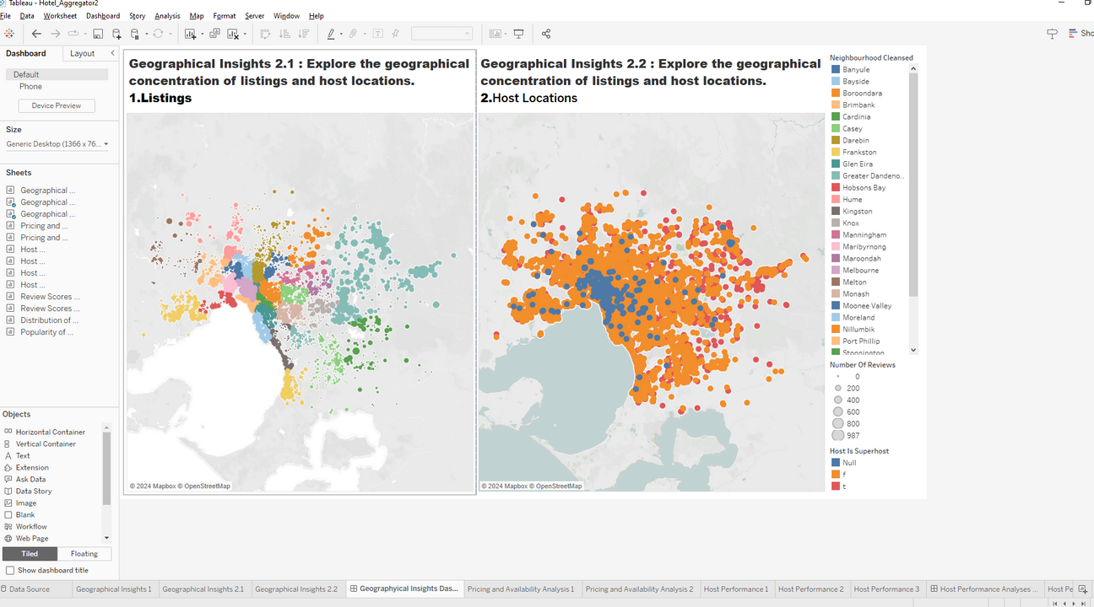
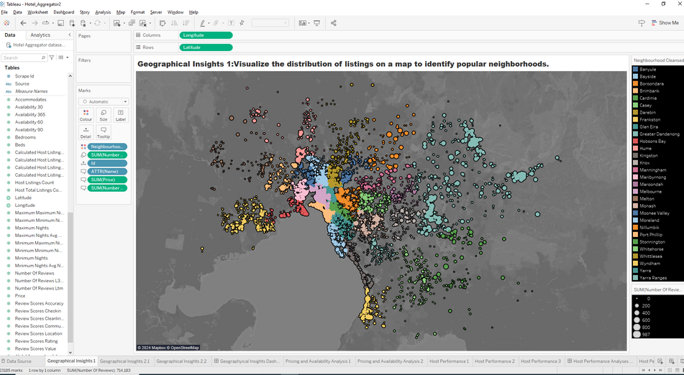
01 - GEOGRAPHICAL INSIGHTS:
Popular Neighbourhood Ex: Melbourne ,Port Philip
Listing and Host Location
03 - SOCIAL MEDIA

Slide 6
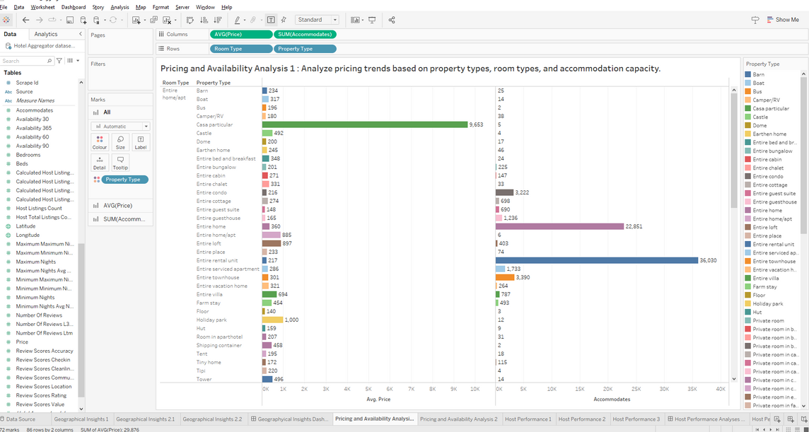
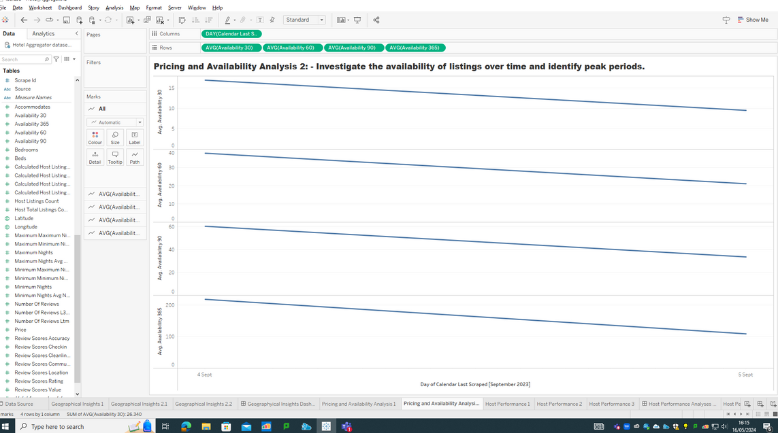
02 - PRICING AND AVAILABILITY ANALYSIS:
Analyse pricing trends based on property types, room types, and accommodation capacity.
Investigate the availability of listings over time and identify peak periods.

Slide 7
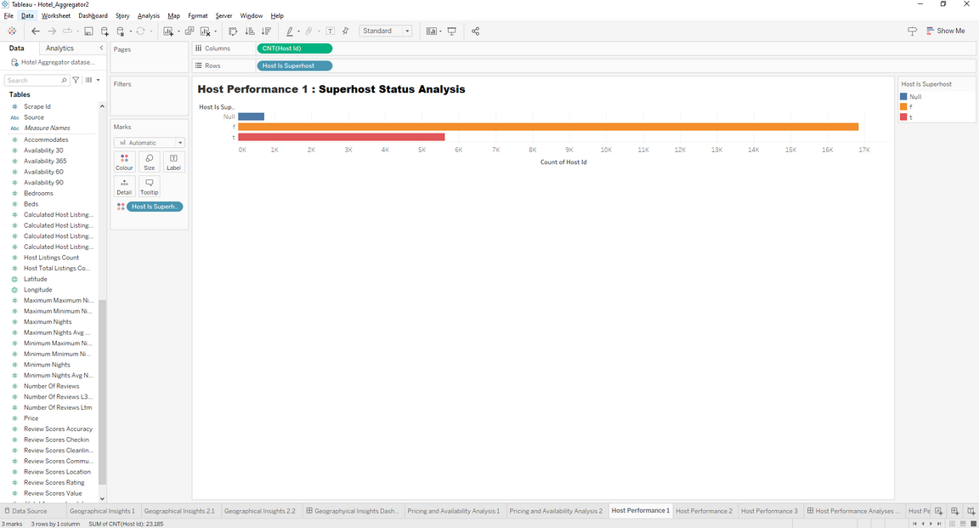
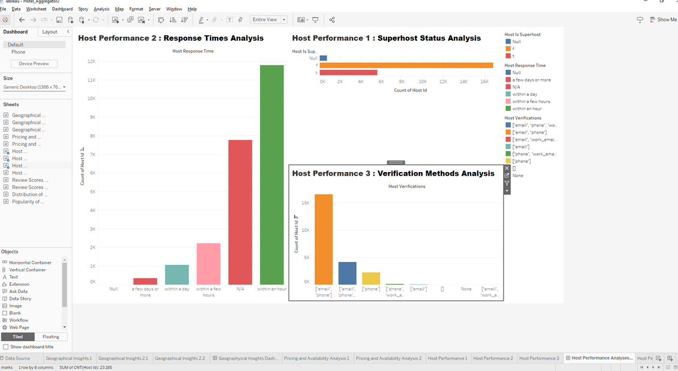
03 - HOST PERFORMANCE:
Evaluate host characteristics, including superhost status, response times, and verification methods.
Explore correlations between host attributes and listing performance.

Slide 8
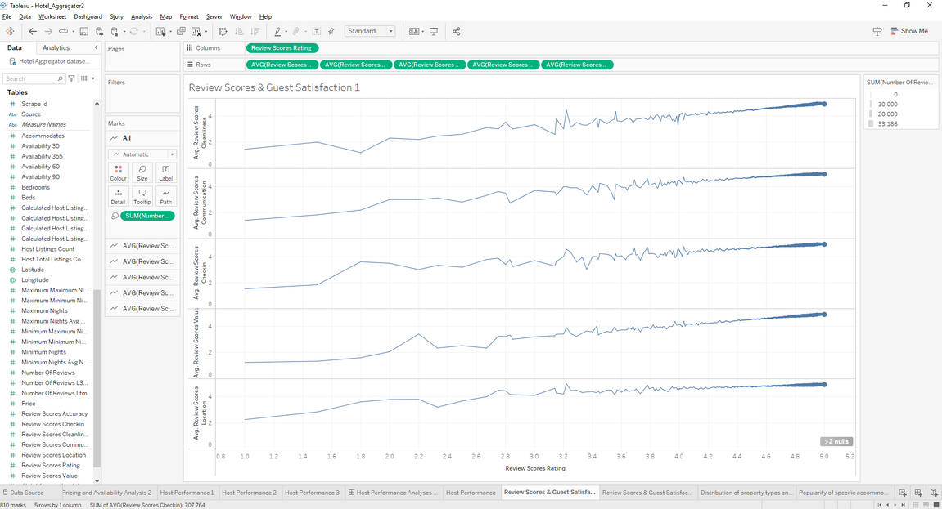
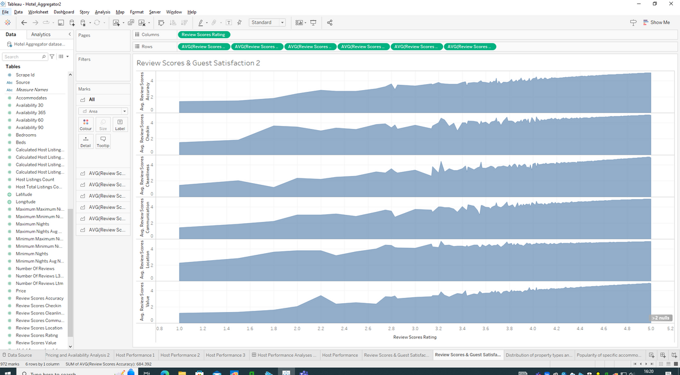
04 - REVIEW SCORES AND GUEST SATISFACTION:
Examine review scores and their impact on overall listing performance.
Identify areas for improvement based on specific review categories.

Slide 9
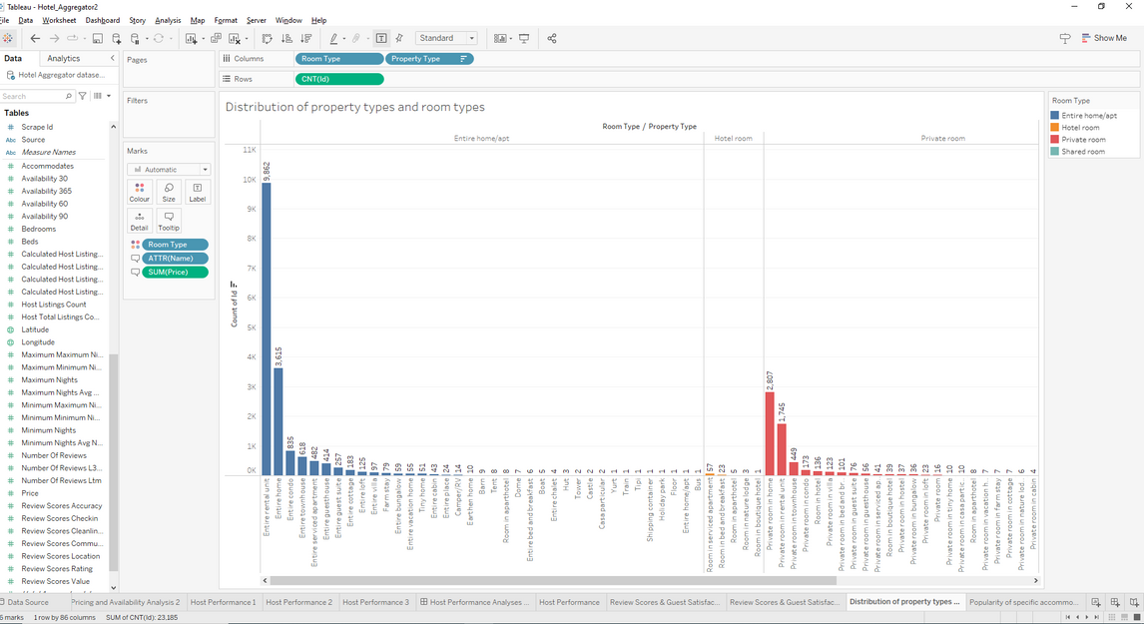
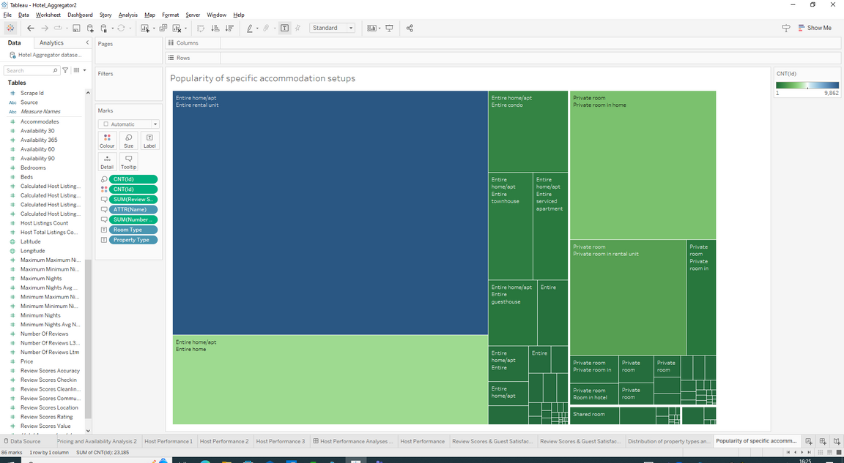
05 - PROPERTY TYPE AND ROOM ANALYSIS:
Analyse the distribution of property types and room types.
Explore trends in the popularity of specific accommodation setups.

Slide 10
THANK YOU
Git: https://github.com/bhavanarajsn/Mentorness

